Slide 1
MYLEGION: Understanding My Groups
Understand group management. View and email members, global member search, view group attributes and services, and review officer materials.
2026
Notes:
MyLegion is The American Legion’s membership website. Through MyLegion, members of The American Legion and Sons of the American Legion can view and manage their membership on file at National Headquarters. Adjutants and commanders, through their individual accounts, will have a My Groups area to assist with post and squadron administrative tasks.

Slide 2
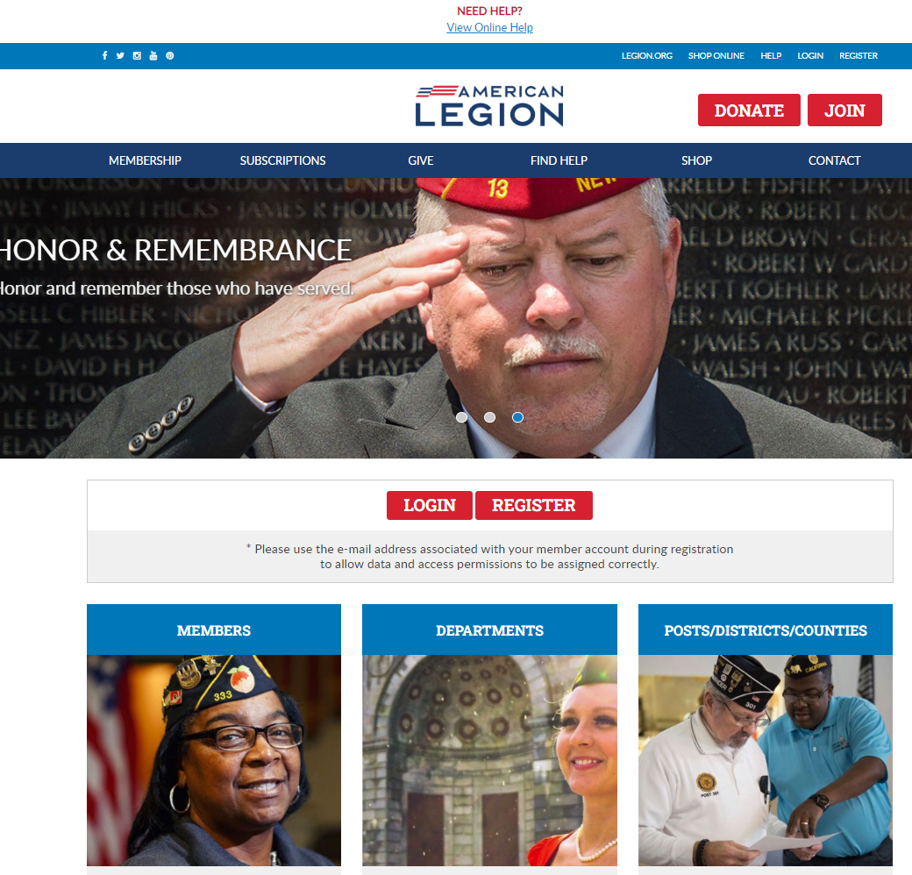

Log in or register a myLegion account to view and manage membership.
Notes:
Administrative membership management tools are available through MyLegion. Begin by logging into MyLegion.

Slide 3
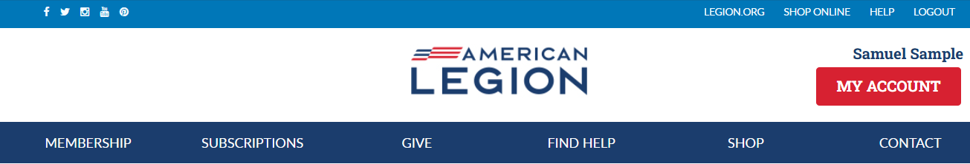
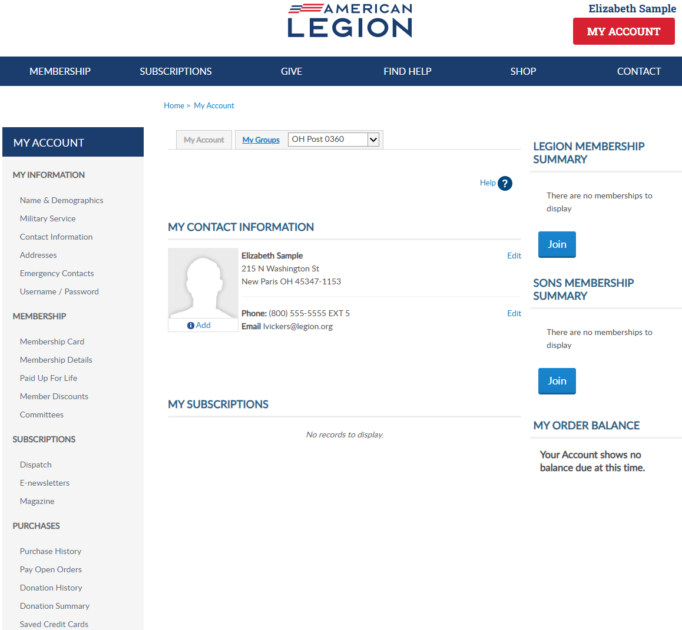
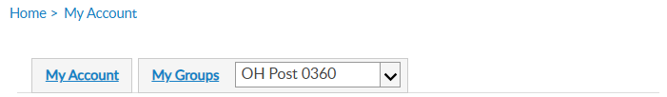

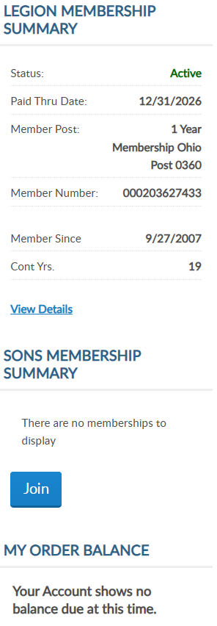
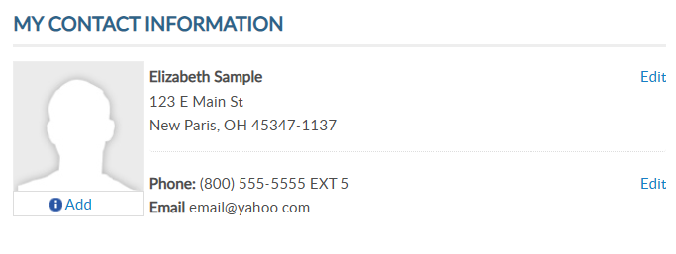
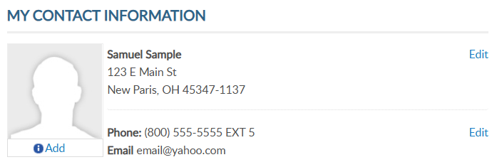
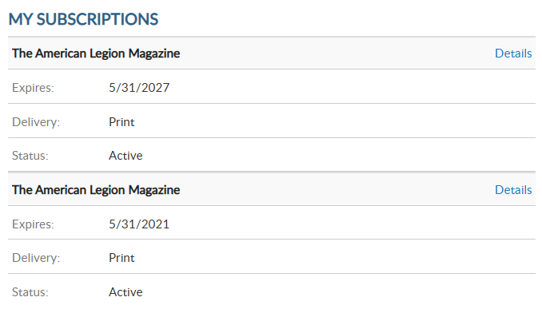
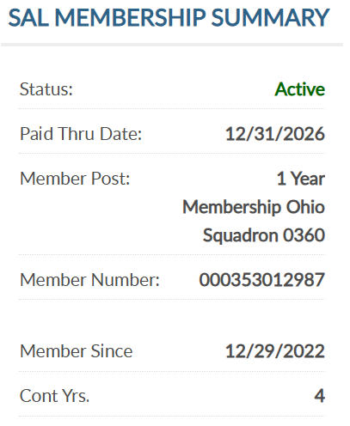

Adjutants, commanders and assigned admins will have a MyGroups menu.
MYLEGION.ORG
No group menu? Contact your department headquarters.
000123456789
000123456789
Notes:
MyLegion first displays information about your membership for both The American Legion and Sons of the American Legion.
Adjutants, commanders and assigned administrators will have a My Groups menu. My Groups is the administrative side of myLegion available to. <1> If you do not have a My Groups menu and are a current adjutant or commander, contact your department headquarters.

Slide 4
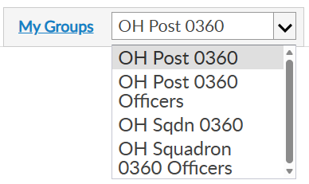

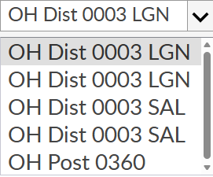
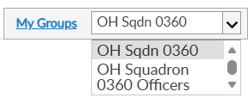

GROUP DEFINITIONS
Post Adjutant & Commander
View Only
View Only
Officer Groups are View Only
Notes:
Groups are defined as a post, squadron, county, district, detachment and department. Adjutants and commanders have My Groups by default.
With each group, adjutants and commanders will have an officer’s group. Officer groups provide a list of current and future officers. It is not the group to select to perform administrative tasks.

Slide 5
GROUP | ADMINISTRATIVE OFFICERS
Post Post Officer | Post Adjutant & Commander
Squadron Squadron Officer | Squadron Adjutant & Commander
County County Officer | County Adjutant & Commander
District District Officer | District Adjutant & Commander
Detachment Detachment Officer | Detachment Adjutant & Commander
Department Department Officer | Department Adjutant & Commander
GROUP DEFINITIONS
Officer Groups are View Only
View Only
View Only
Notes:
Groups are defined as a post, squadron, county, district, detachment and department. Adjutants and commanders have My Groups by default.
With each group, adjutants and commanders will have an officer’s group. Officer groups provide a list of current and future officers. It is not the group to select to perform administrative tasks.

Slide 6
MY GROUPS
Adjutants and Commanders
Post, Squadron, District, County, Dept, Detach
Legion has LGN and SAL
Officer Groups: view only
000123456789
Select group to transition to the admin side of myLegion.
000123456789
Notes:
This member is a post adjutant and has 4 groups by default. <1> Legion leadership have access to both Legion and Sons of the American Legion groups. <2> Officer groups are view only. Officer groups lists the officers on file.
Clicking on the group will navigate you to the administrative side of MyLegion. Let’s look at an officer’s group. <4>

Slide 7
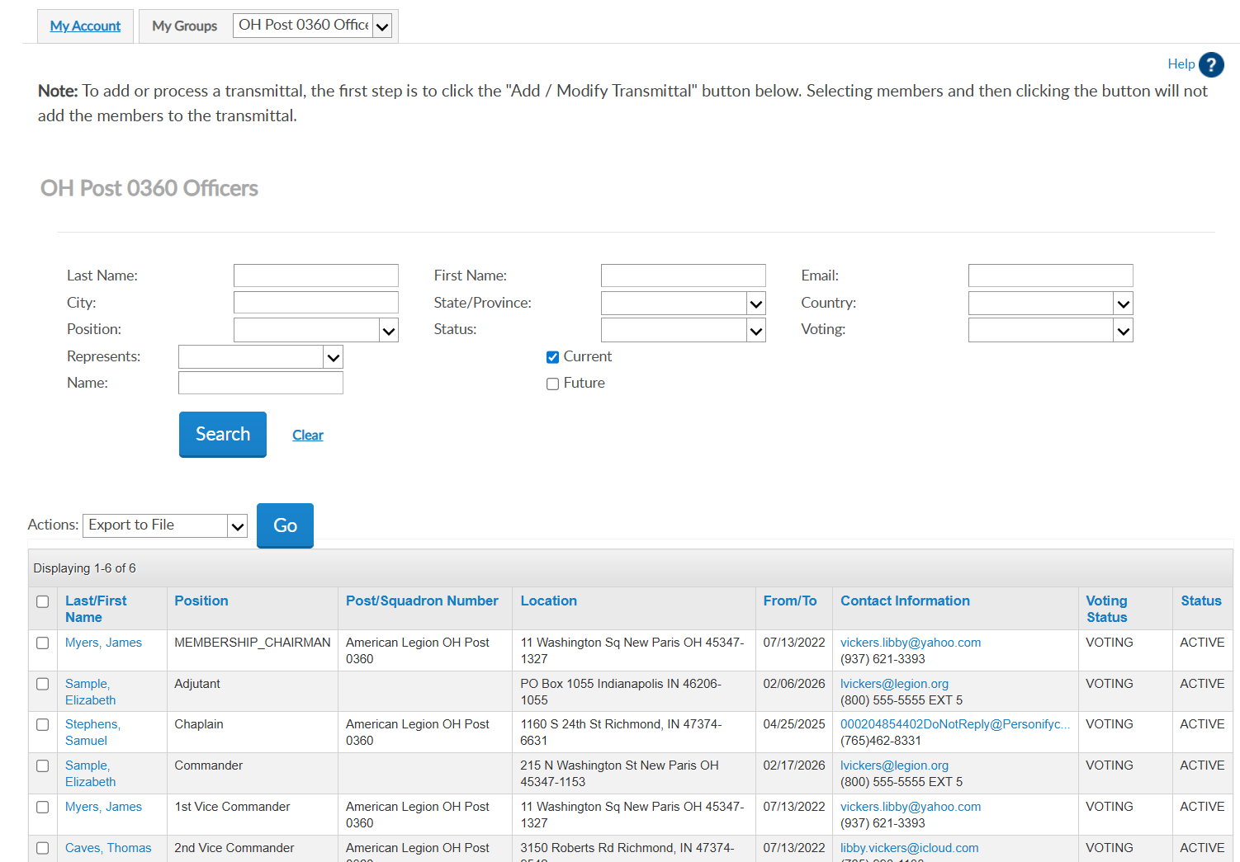

OFFICER GROUPS
Officer Groups: view only
Report Officer updates through Dept HQs using an Officer’s Certification Form
View Future Officers
Officer updates cannot be made through myLegion.
Last, First | FINANCE_OFFICER | American Legion Post 0360 | Address | 07/07/2025 07/07/2026 | Email Address Phone | VOTING | ACTIVE
Last, First | SERVICE_OFFICER | American Legion Post 0360 | Address | 07/07/2025 07/07/2026 | Email Address Phone | VOTING | ACTIVE
Last, First | Adjutant | American Legion Post 0360 | Address | 07/07/2025 07/07/2026 | Email Address Phone | VOTING | ACTIVE
Last, First | Commander | American Legion Post 0360 | Address | 07/07/2025 07/07/2026 | Email Address Phone | VOTING | ACTIVE
Last, First | Chaplain | American Legion Post 0360 | Address | 07/07/2025 | Email Address Phone | VOTING | ACTIVE
Last, First | Vice Commander | American Legion Post 0360 | Address | 07/07/2025 07/07/2026 | Email Address Phone | VOTING | ACTIVE
Notes:
Officer group allows you to view officers reported and entered in national’s membership system. <1> Report officers through your department headquarters using the Officer Certification form. <2> You can view future officers already recorded. <3> Officer updates cannot be made through MyLegion.

Slide 8

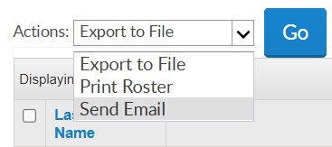
OFFICER GROUPS
myLegion allows you to email a single member or group of members.
Outlook imposes several email restrictions, including sending limits, attachment size limits, and message delivery restrictions, which can impact your email communications.
Last, First | FINANCE_OFFICER | American Legion Post 0360 | Address | 07/07/2025 07/07/2026 | Email Address Phone | VOTING | ACTIVE
Last, First | SERVICE_OFFICER | American Legion Post 0360 | Address | 07/07/2025 07/07/2026 | Email Address Phone | VOTING | ACTIVE
Last, First | Adjutant | American Legion Post 0360 | Address | 07/07/2025 07/07/2026 | Email Address Phone | VOTING | ACTIVE
Last, First | Commander | American Legion Post 0360 | Address | 07/07/2025 07/07/2026 | Email Address Phone | VOTING | ACTIVE
Last, First | Chaplain | American Legion Post 0360 | Address | 07/07/2025 | Email Address Phone | VOTING | ACTIVE
Last, First | Vice Commander | American Legion Post 0360 | Address | 07/07/2025 07/07/2026 | Email Address Phone | VOTING | ACTIVE
CExample, Thomas | FINANCE_OFFICER | American Legion Post 0360 | Address | 07/07/2025 07/07/2026 | Email Address Phone | VOTING | ACTIVE
CExample, Curtis | SERVICE_OFFICER | American Legion Post 0360 | Address | 07/07/2025 07/07/2026 | Email Address Phone | VOTING | ACTIVE
CExample, DJ | Adjutant | American Legion Post 0360 | Address | 07/07/2025 07/07/2026 | Email Address Phone | VOTING | ACTIVE
CExample, Helen | Commander | American Legion Post 0360 | Address | 07/07/2025 07/07/2026 | Email Address Phone | VOTING | ACTIVE
CSample, Elizabeth | Chaplain | American Legion Post 0360 | Address | 07/07/2025 | Email Address Phone | VOTING | ACTIVE
CSample, Jesse | Vice Commander | American Legion Post 0360 | Address | 07/07/2025 07/07/2026 | Email Address Phone | VOTING | ACTIVE
Notes:
Send an email to all or selected officers, select the records, go to the Actions menu and choose Send Email.
Outlook is the default browser for emailing through myLegion. Outlook imposes several email restrictions, including sending limits, attachment size limits, and message delivery restrictions, which can impact your email communications.

Slide 9
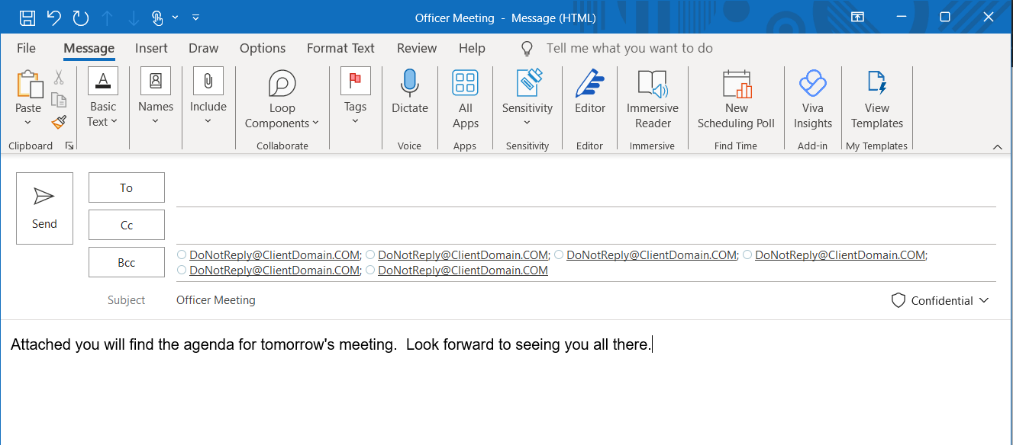
OFFICER GROUPS
Notes:
Notice the email addresses are in as a blind copy. Recipients of the email cannot see who else received the message.

Slide 10
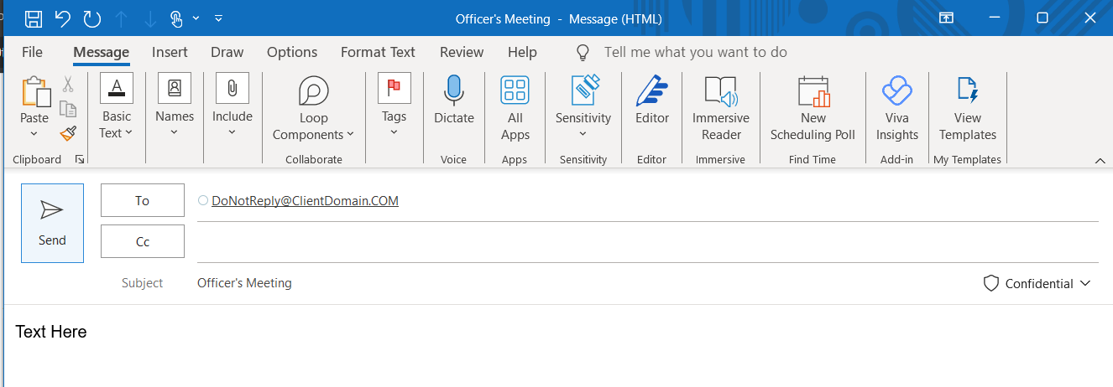
OFFICER GROUPS
Email a single member.
Last, First | FINANCE_OFFICER | American Legion Post 0360 | Address | 07/07/2025 07/07/2026 | Email Address Phone | VOTING | ACTIVE
Last, First | SERVICE_OFFICER | American Legion Post 0360 | Address | 07/07/2025 07/07/2026 | Email Address Phone | VOTING | ACTIVE
Last, First | Adjutant | American Legion Post 0360 | Address | 07/07/2025 07/07/2026 | Email Address Phone | VOTING | ACTIVE
Last, First | Commander | American Legion Post 0360 | Address | 07/07/2025 07/07/2026 | Email Address Phone | VOTING | ACTIVE
Last, First | Chaplain | American Legion Post 0360 | Address | 07/07/2025 | Email Address Phone | VOTING | ACTIVE
Last, First | Vice Commander | American Legion Post 0360 | Address | 07/07/2025 07/07/2026 | Email Address Phone | VOTING | ACTIVE
Notes:
Click on the email address of a single member and an email will open. <1>

Slide 11
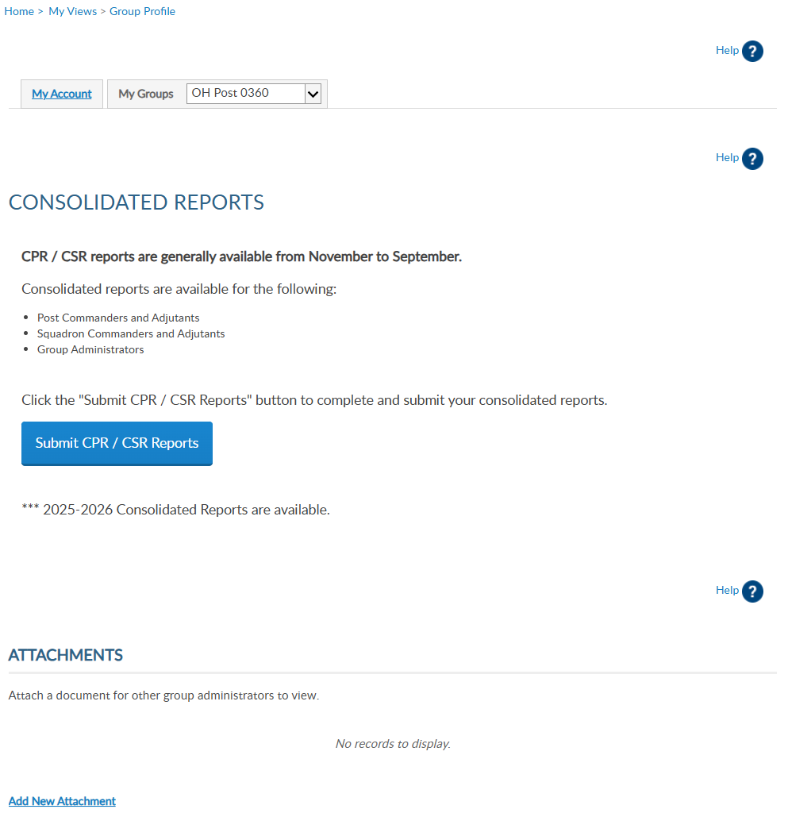
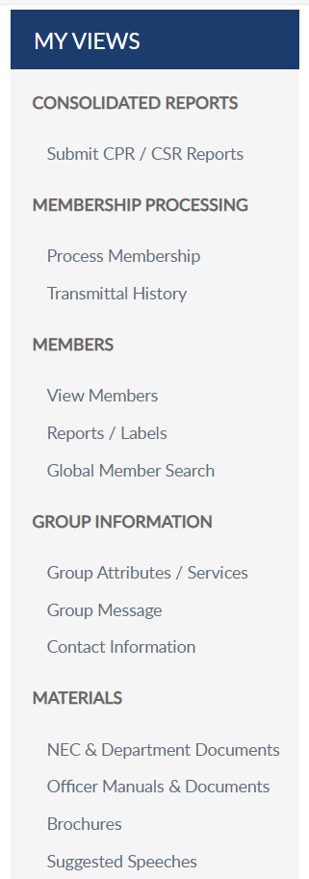

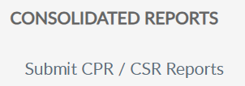
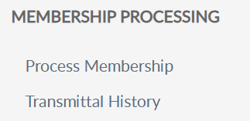
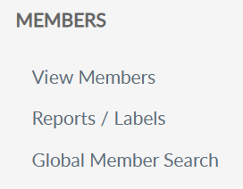
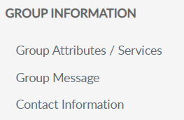
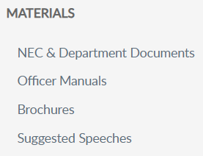
GROUP PROFILE
Notes:
Selecting the post group takes you to a Group Profile page which is the administrative side of MyLegion. A new left hand “My Views” menu <1> of administrative tools such as reports, online membership processing, member management, group information and officer materials.

Slide 12
GROUP PROFILE
Notes:
View members opens a list of members currently in the post or squadron.

Slide 13
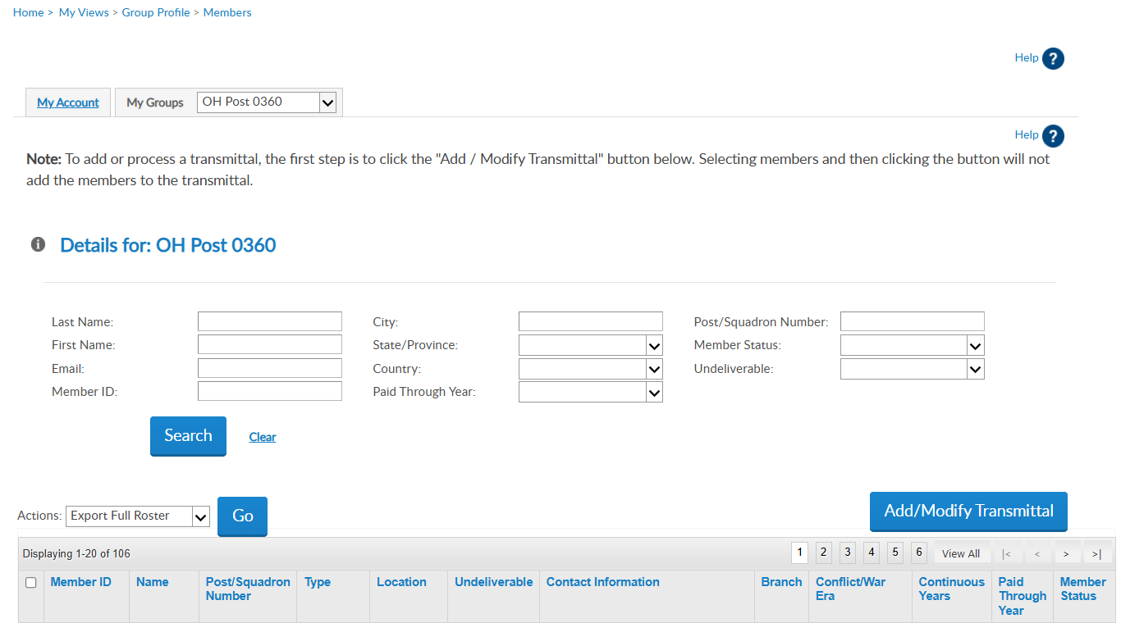

Use “view members” for:
Quick view of member info
Member Maintenance (dist/cty view only)
Email communications
Add/Modify Transmittal (post/sqdn/dept/detach)
VIEW MEMBERS LIST
Member ID | Last, First | American Legion OH Post 360 | 1 Year Mbrship | Address |  | email address Phone | USAF | VIETNAM | 5 | 2025 | Expired
Member ID | Last, First | American Legion OH Post 360 | PUFL renewal | Address |  | Phone | USAF | KOREA | 49 | 2026 | Active
Member ID | Last, First | American Legion OH Post 360 | 1 Year Mbrship | Address |  | email address Phone | USA | VIETNAM | 20 | 2027 | Active
102222456
Notes:
Search fields allow you to search with various options. If you do not find the member in the list, return to Group Profile and use Global Member Search or go to Reports. Suggested reports to use are Post/Squadron Current Roster and/or Roster Updates to determine if the member has transferred out or expired for 2 years or greater.
Use “view members to quickly member information, update a member’s record (district and county group access provide view only), send Email communications and transition to online membership processing using Add/Modify Transmittal. Distirct and county access will not include an Add/Modify Transmittal button.

Slide 14
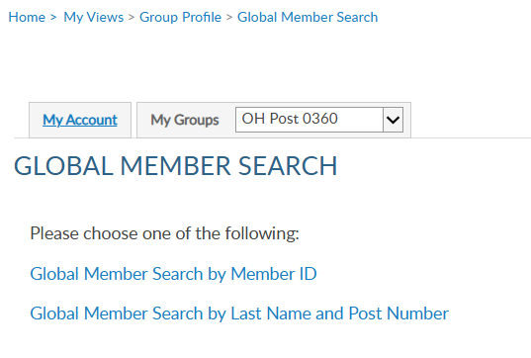
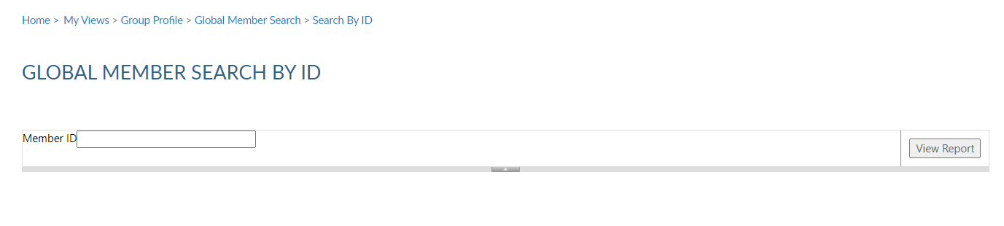
IMPORTANT INFO
Notes:
Global member search allows you to view members outside of your group. Two options are provided. Search by ID or search by name with post number.
<1>Search by ID allows you to enter a Legion or Son of The American Legion membership number to view limited information. <2>Enter the ID number, click View Report to view name, member type, paid post or squadron, and last paid year.

Slide 15
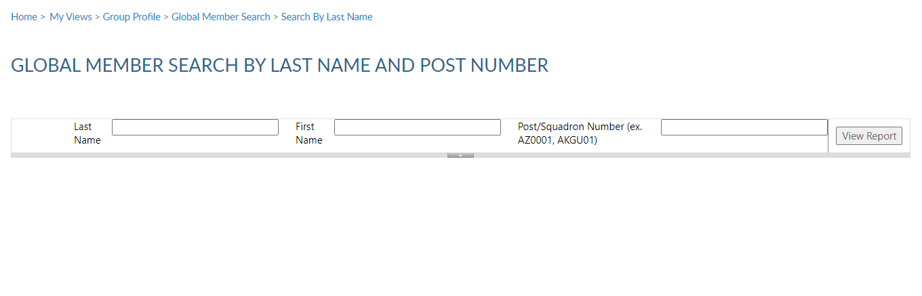
IMPORTANT INFO
Notes:
Search by last name and number requires both pieces of information. <1>Click View Report to view.<2>
This information can assist with transferring members and eligibility for The American Legion Auxiliary and Sons of the American Legion.

Slide 16
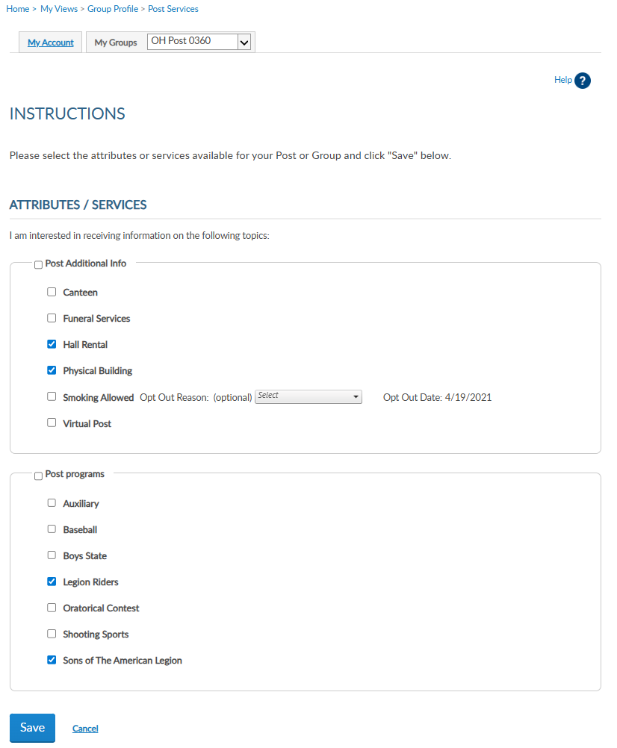
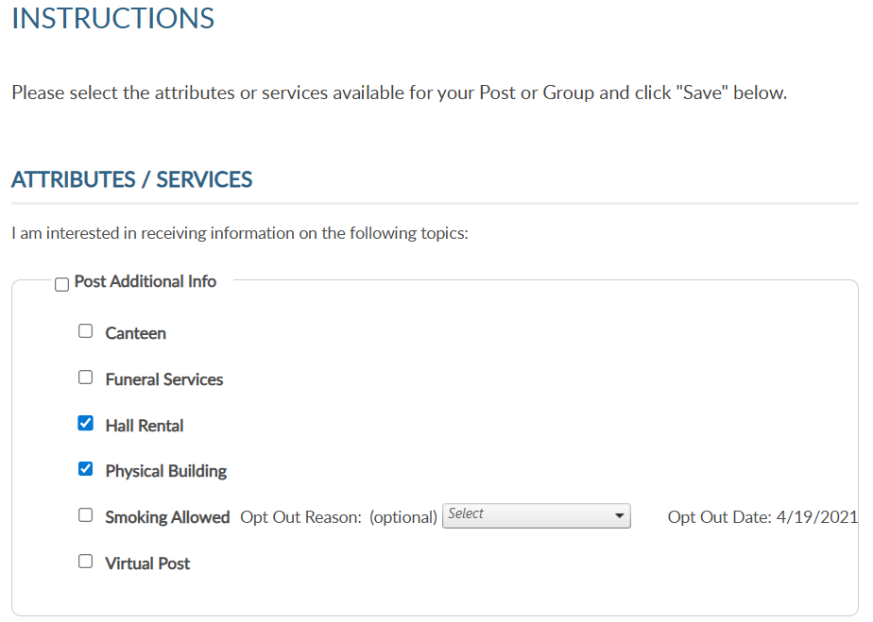
GROUP SERVICES
Notes:
Group Information allows officers to provide information about their attributes and services, add a group message and updated contact information.
Let’s look at group attributes and services. <1> Group attributes can assist by providing additional information about your group that can be seen through Legion.org Find Help find a post.

Slide 17
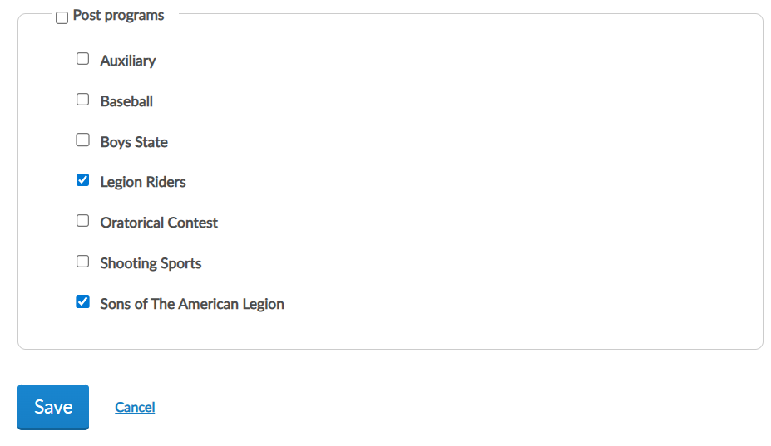
GROUP SERVICES
Notes:
Check the boxes that apply the post supports and save. To remove, simply uncheck the appropriate box and save updates.

Slide 18
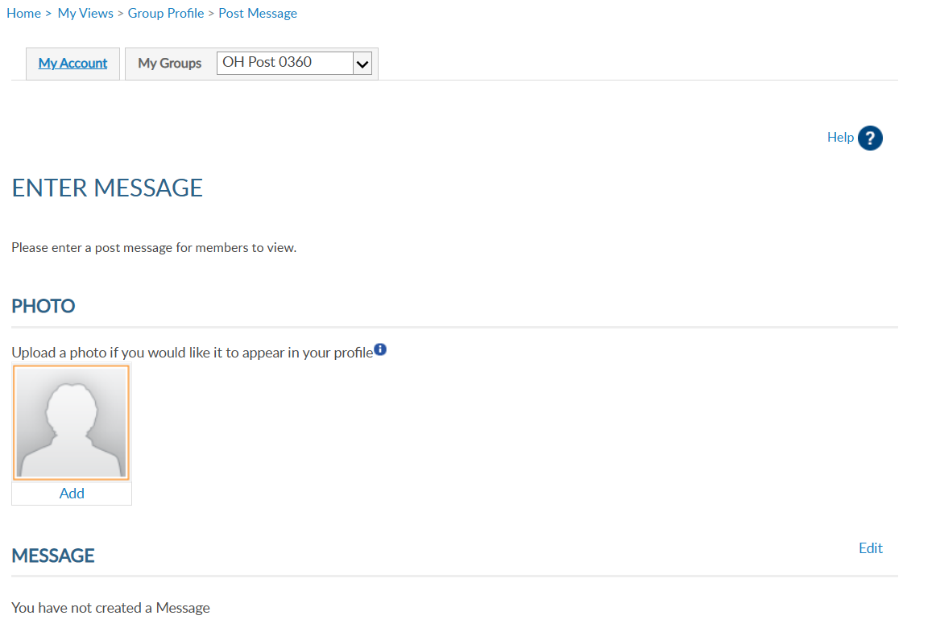
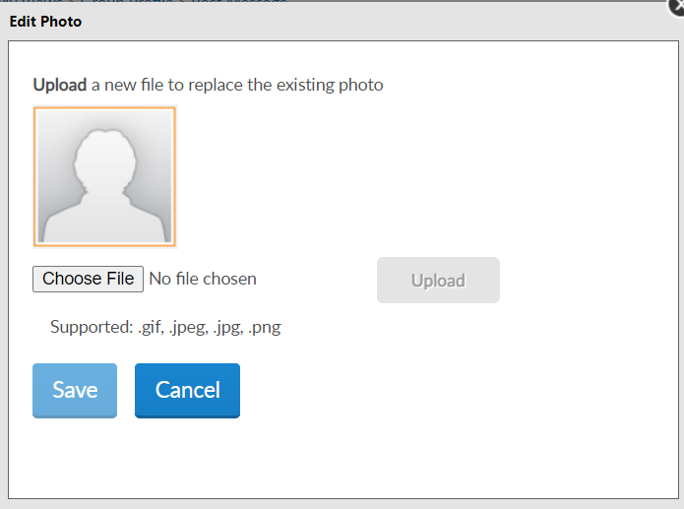
GROUP IMAGE
Notes:
Group message includes adding a message and an image for your group.
To add a photo of your building, or other image identifying your group, click Add <1>. Click choose file.

Slide 19
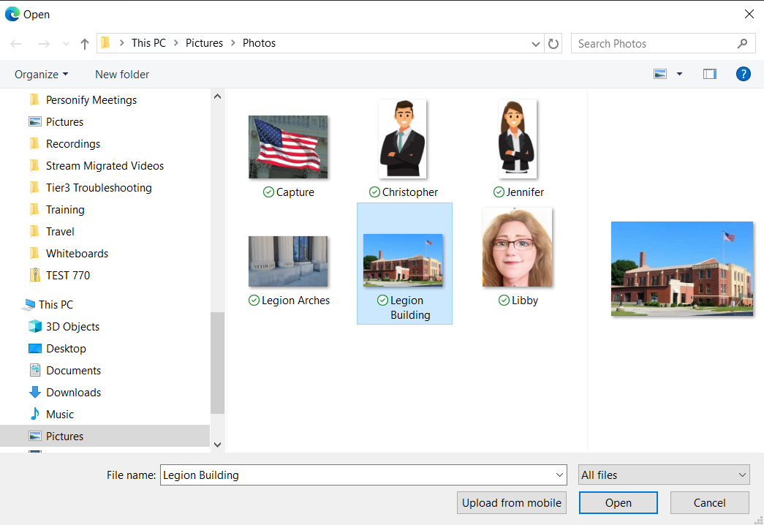
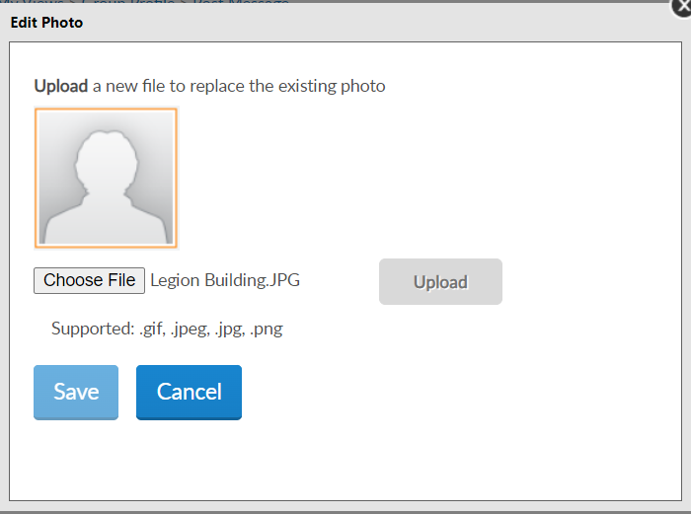
GROUP IMAGE
Notes:
Find the image and click “Open”. <1> The edit photo window opens with the file selected. Click “Upload” for the image to appear.

Slide 20
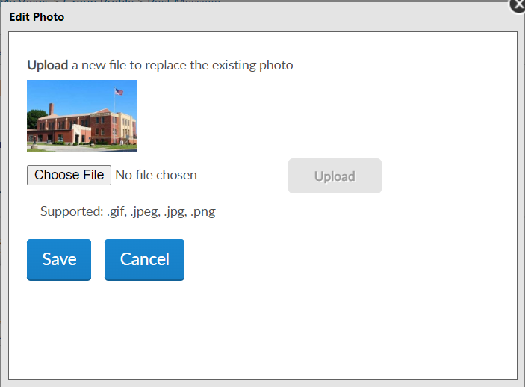
GROUP IMAGE
Notes:
The image will appear. Save to add the image to your group profile.

Slide 21

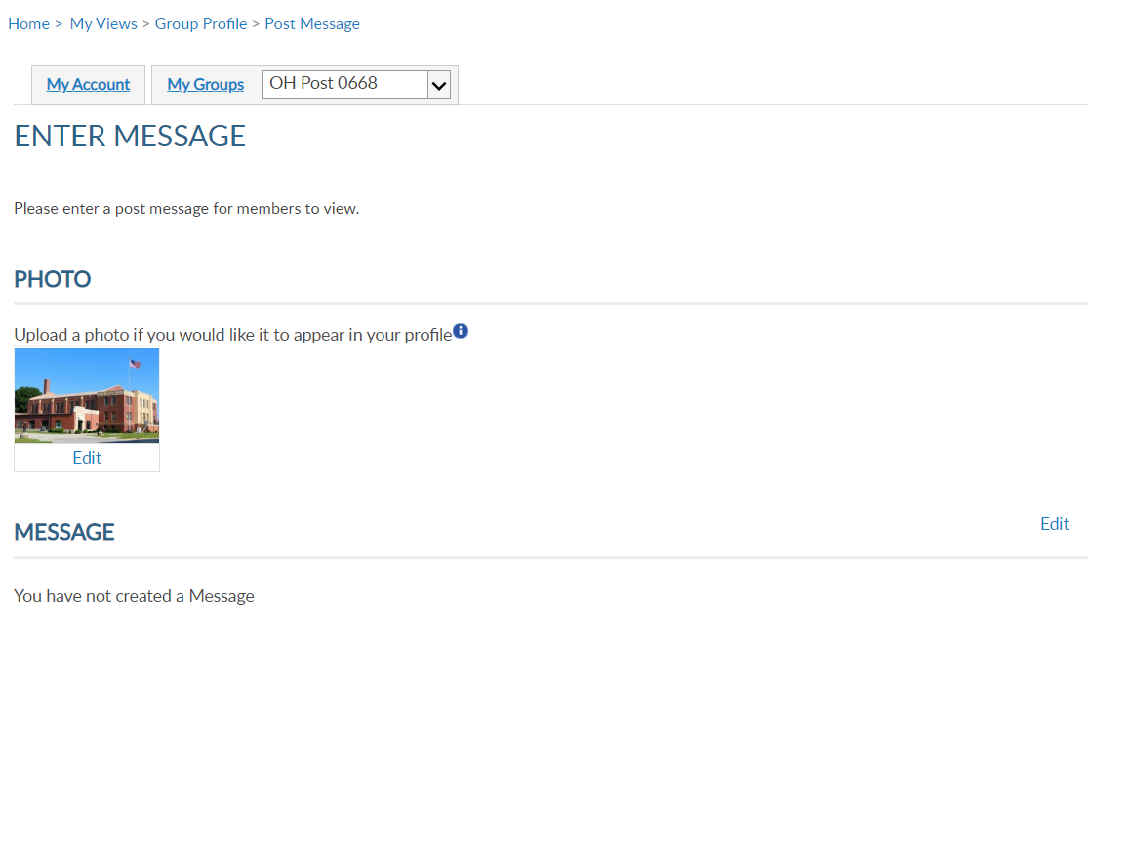
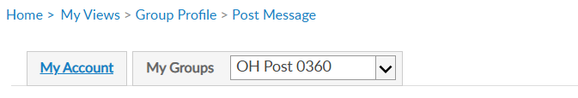
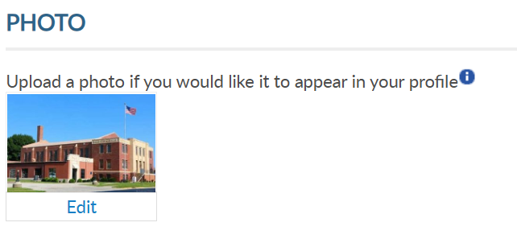
GROUP IMAGE
Notes:
The photo image appears and will also appear in post locator, Find a Post. You can remove or edit the image using the Edit link.

Slide 22
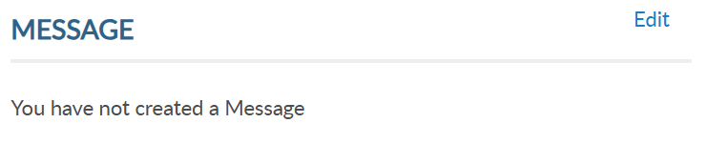
GROUP MESSAGE
Notes:
A brief message about meetings, special events or programs your post supports can be added to your group information. It is important that if posting a message to keep it current. This message will be published to Legion.org, “Find A Post”.
Click Edit to add, update or delete text.

Slide 23
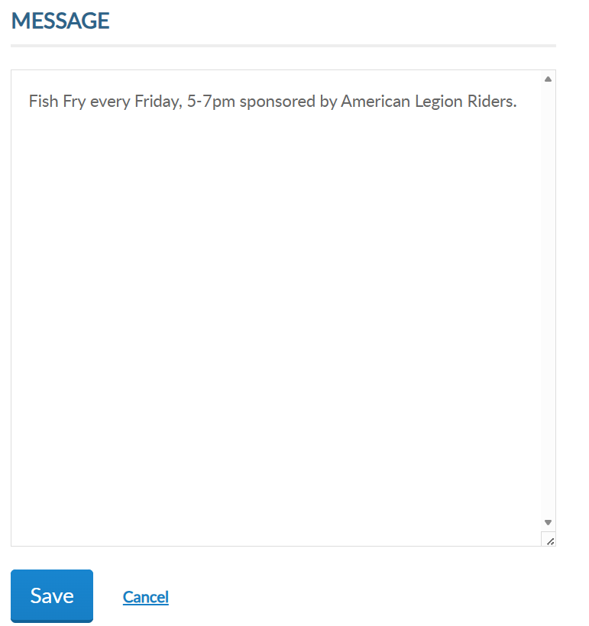
GROUP MESSAGE
Notes:
Type the message and “save”.

Slide 24
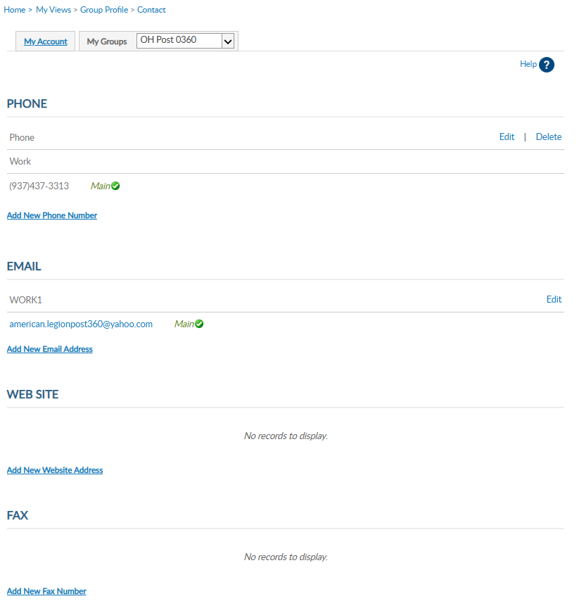
GROUP CONTACT INFO
Notes:
Group contact information allows administrators to update contact information including phone, email website and fax. This information can be seen on Legion.org’s Find a Post.
Use Add, Edit or Delete options to update group contact information.
This does not replace Post Data Reports. In February, the annual Post Data Report is mailed to department headquarters for distribution to posts. Each form is pre-printed with current contact information form National HQ’s data system. This pre-printed form for the post is sent for annual spring reporting. When there is a change, notify department headquarters. All changes must first go through department headquarters for processing. Any changes received by NHQs directly from a post will be returned with no action taken.

Slide 25
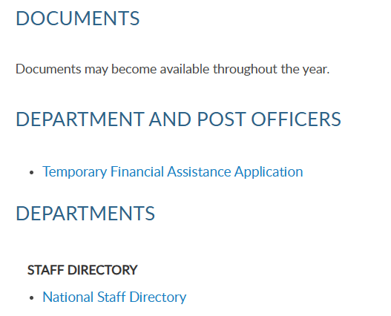
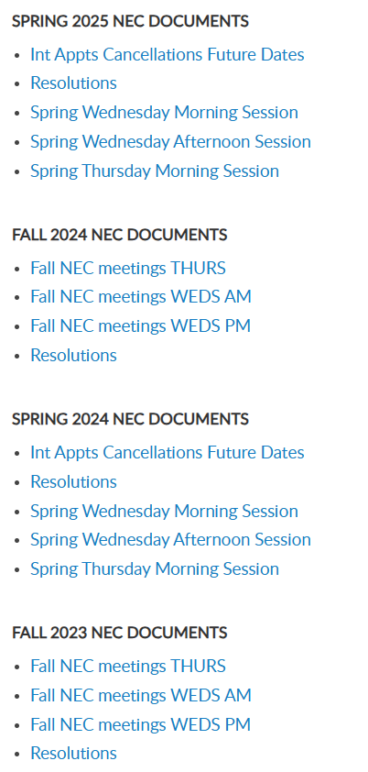
MATERIALS > DOCUMENTS
Notes:
Materials include NEC documents, manuals, brochures, and suggested speeches. The documents area includes a national staff directory, and minutes from the National Executive Committee meetings.

Slide 26
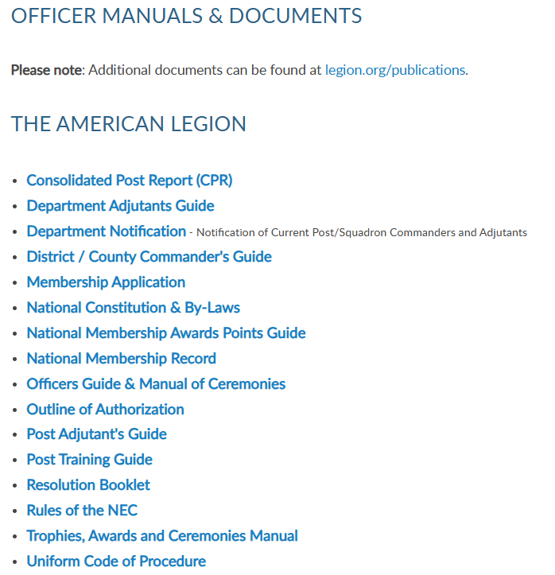
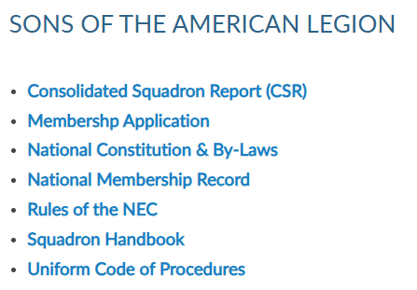
MATERIALS
Notes:
Officer Manuals are available to download. Select the title to link to publications on Legion.org to download.

Slide 27
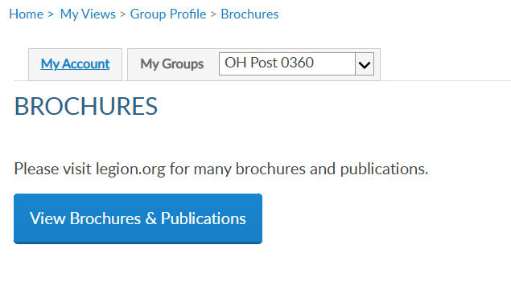
MATERIALS
Notes:
Access brochures and national publications related to Americanism and Children & Youth services and more.

Slide 28
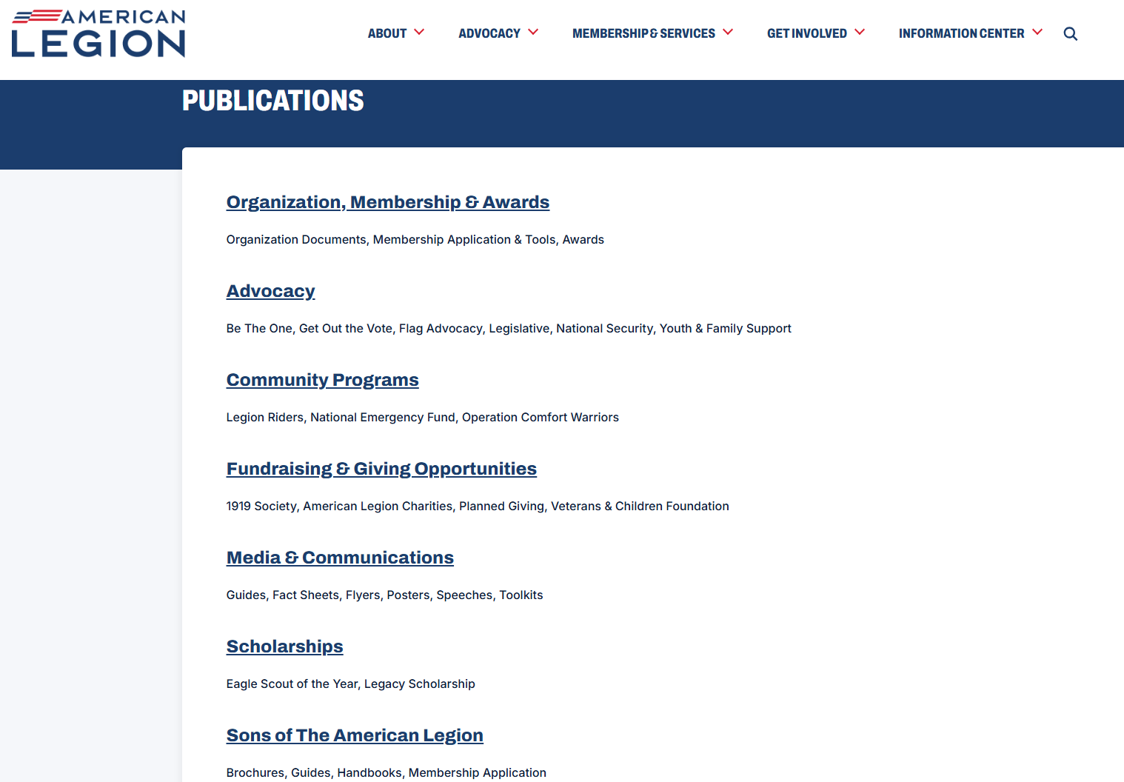
MATERIALS
Notes:
A wide variety of publications are available to download.

Slide 29
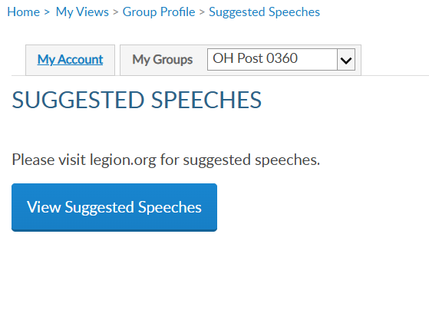
MATERIALS
Notes:
Every year The American Legion provides speeches to use as a guideline during events and observances. Select View Suggested Speeches to view published speeches.

Slide 30
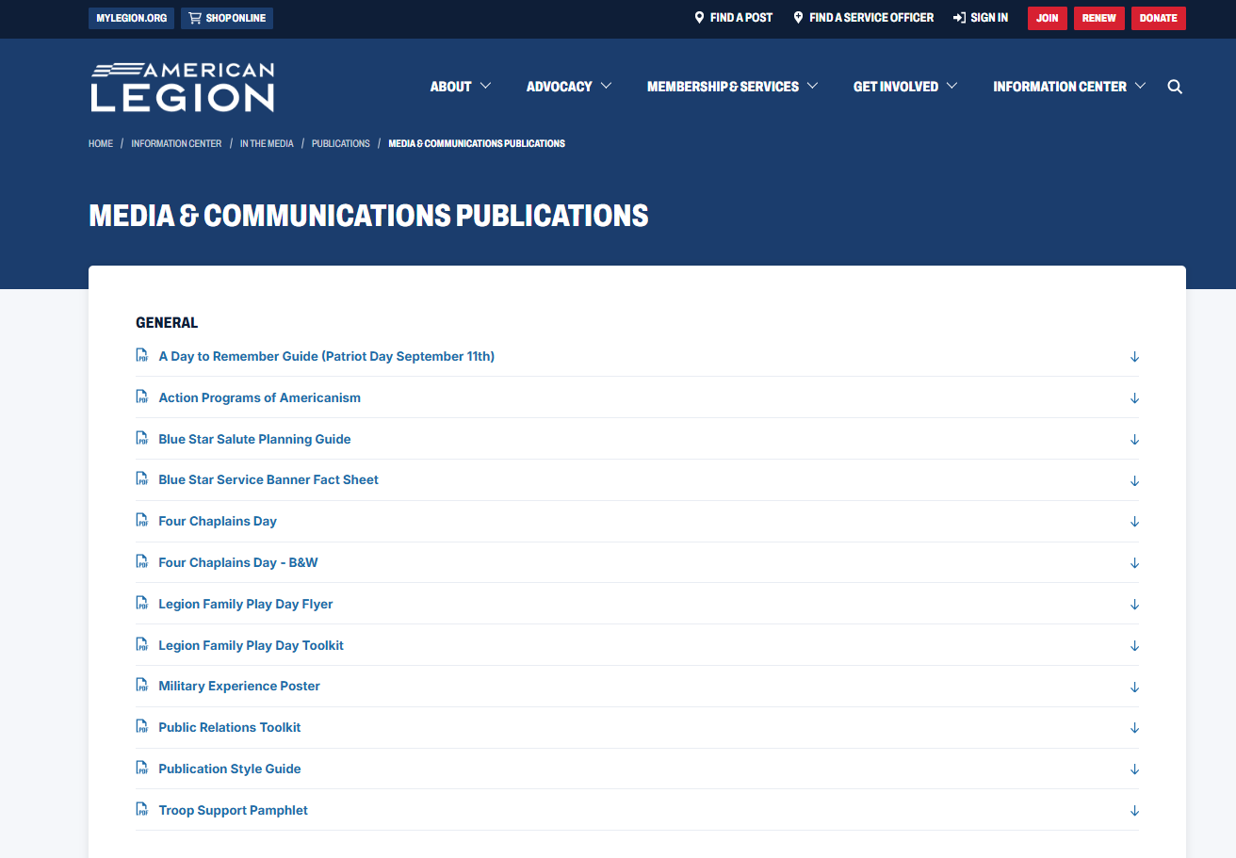
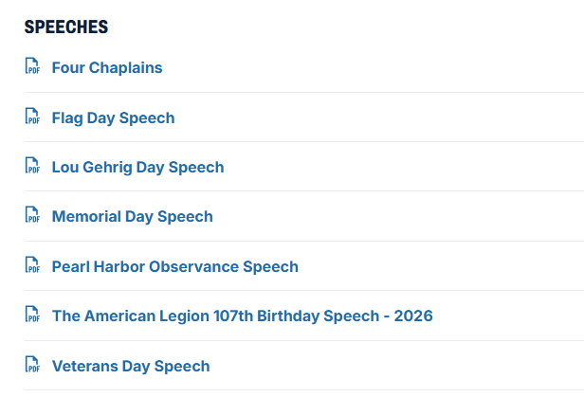
LEGION.ORG
Notes:
All speeches available can be downloaded.

Slide 31



HELP - FIND A POST
000123456789
000123456789
Notes:
MyLegion publishing tools are visible in Help, Find A Post accessed through MyLegion and Legion.org. Find a post allows search of a post or squadron by location.

Slide 32


HELP - FIND A POST
Notes:
Additional search options include country, state, type, attributes, services and programs. Attributes listed are pulled from your group information. Enter search criteria and click Go.

Slide 33


HELP - FIND A POST
Notes:
My search is set for 10 miles from a zip code. This opens a post directory and details such as phone, email, and post programs. However, post type and address are reported using the post data report provided by your department headquarters.
View details opens more information about the post.

Slide 34



HELP - FIND A POST
Annual Forms
Post Data Form
Officer Certification
Notes:
Go to View Details to view additional information such as current adjutant and commander. It is important to submit the required forms for leadership, dues, and address updates. Post Data Forms and Officer Certification forms are available from your department.

Slide 35



HELP - FIND A POST
Fish Fry every Friday, 5-7pm sponsored by American Legion Riders.
Notes:
A standard message is displayed. This message can be updated using Group message. If you have customized the image or message, it appears here.

Slide 36

HELP - FIND A POST
Contact information, dues and meeting information is reported on the Post Data Report.
Notes:
Contact information, dues and meeting information is reported on the Post Data Report.

Slide 37

HELP - FIND A POST
Notes:
Organizations and amenities can be reported on the Post Data Form or maintained through myLegion.

Slide 38

Online Help
Notes:
Step by step instructions, videos and training presentations will assist with how to manage groups in MyLegion. My Groups instructions include managing membership, online, membership processing, reports and all other administrative tasks.

Slide 39
MYLEGION SUPPORT
MyLegion@legion.org
833.253.9995
Monday – Friday
8:00am – 4:30pm
(Eastern)
The American Legion National HQs
5745 Lee Road
Indianapolis, IN 46216
Contact your MyLegion support team to assist with any questions or tools on your MyLegion account.
Notes:
Contact your myLegion support team to assist with questions and tools for MyLegion. Email mylegion@legion.org or call 833-253-9995 Monday through Friday.

